Slide 1
“DISCREETLY OPEN”
Accelerate Group 4 Nodejs projecT
To confess openly yet discreetly, in style.
~“May the confessions be ever in your favour”~
Lea Ho
Christy Law
Wilson Lau
May the confessions be ever in your favour

Slide 2
“DISCREETLY OPEN”
It sounds wrong?
No you are wrong ☺
Psychological remedy
Social awareness
Sense of social responsibility
So what does it do?
You don’t need a tree hole anymore

Slide 3
“DISCREETLY OPEN”
Why DO it?
An online social platform for creating anonymous confessions, appealing to injustice, and delivering constructive advice to the "criminals" and the "victims".
- posts are made anonymously and inappropriate content will be filtered
- seeking advice and encouragements
- constructive solutions for problems and help each other in the society
You don’t need a tree hole anymore!
Let’s share the sorrow and thoughts together!
Everyone could be an angel to the others.
You don’t need a tree hole anymore

Slide 4



“DISCREETLY OPEN”
Competitors
Reddit
Facebook Groups
Forums
You don’t need a tree hole anymore

Slide 5
“DISCREETLY OPEN”
Featured Features
1 Authentication
Register an account
Login
Logout
2 Create anonymous posts (image is optional) in the role of
A Victim" of the specific event (Appeal)
A Criminal" of the specific event (Confession)
3 Post sorting
4 Give advice to the owners of the posts
5 Access to all the posts “I” created
6 Access to all the advice(comments) “I” gave
You don’t need a tree hole anymore

Slide 6
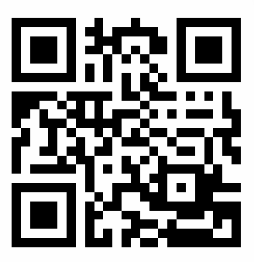
“DISCREETLY OPEN”
Let’s DO it!
Demonstration show time~
You don’t need a tree hole anymore

Slide 7
“DISCREETLY OPEN”
Design approach
1 Mind-map as a brainstorming tool 2 Wireframing and prototyping 3 Lucid-Chart as database designing tool
You don’t need a tree hole anymore

Slide 8
“DISCREETLY OPEN”
Built with
NodeJS Express Handlebars Postgresql and KnexJS CSS JavaScript With the use of: Bootstrap 4.1 (front-end framework) Github for collaboration
Production duration : around 3 weeks
You don’t need a tree hole anymore

Slide 9
“DISCREETLY OPEN”
Future Improvements
Vote (similar to like/dislike) Private Groups Update Post Delete Post Favouritelist Other Languages Admin System
You don’t need a tree hole anymore

Slide 10
“DISCREETLY OPEN”
You don’t need a tree hole anymore.
Let’s share the sorrow and advice
To make the world better!
Thank you !
You don’t need a tree hole anymore

Slide 11
“DISCREETLY OPEN”
Thank You Guys :D
You don’t need a tree hole anymore

